Slide 1

BTEC Unit 11 Computer Networks
Key points:
• INTERNET
• CONNECTION TYPES
• SECURITY
• NETWORK UTILITIES
•NETWORK SERVICES
•NETWORK PROTOCOLS

Slide 2
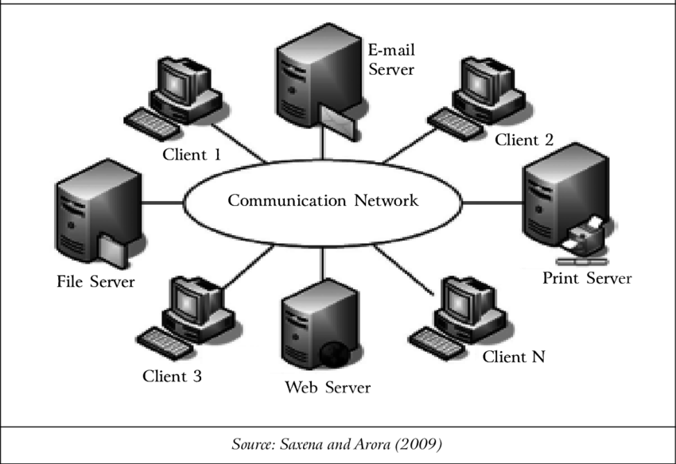
What is a Computer network ?
Computer networking refers to interconnected computing devices that can exchange data and share resources with each other. These networked devices use a system of rules, called communications protocols, to transmit information over physical or wireless technologies.
•Simple Attitude:
-Computer networking refers to connected computing devices (such as laptops, desktops, servers, smartphones, and tablets) and an ever-expanding array of IoT devices (such as cameras, door locks, doorbells, refrigerators, audio/visual systems, thermostats, and various sensors) that communicate with one another.

Slide 3
Difference between wired and wireless connections :
Wired connection
+A wired network employs wires to link devices to the Internet or another network, such as laptops or desktop PCs.
- Example: In the networking world, “Wired” as the name suggests refers to any physical medium connected through wires and cables. The wires/cables can be copper wire, twisted pair or even fibre optic. Wired connectivity is responsible for providing high security with high Bandwidth provisioned for each user.
- In fact, Wired connectivity is considered highly reliable and incurs very low delay, unlike Wireless connectivity.
Wireless connection
+Wireless Network Connections: “Wireless” means without wire, media that is made up of electromagnetic waves (EM Waves) or infrared waves. Antennas or sensors will be present on all wireless devices.
- Example: Cellular phones, wireless sensors, TV remotes, satellite disc receivers, and laptops with WLAN cards are all examples of wireless devices. For data or voice communication, a wireless network uses radiofrequency waves rather than wires.
- Though wireless connectivity is less secured and higher delay than wired connectivity, it is still preferred communication technology for customers. Wireless also earns low Installation cost in contrast to wired connectivity.

Slide 4
Types of networks e.g., LAN WAN SAN
1-LAN is the ‘Local Area Network.’ As the name suggests, it works to connect local computers.
2- A WAN full-form is ‘Wide Area Network.’ It is the types of computer network with many LANs that have a much broader range than LAN and MAN.
3- MAN is the ‘Metropolitan Area Network.’ These types of networks are used to transfer data at high speed within a city.
4- WLAN is ‘Wireless Local Area Network.’ Wireless means connection without physical wire.
5- PAN’s full form is ‘Personal Area Network.’ It is a computer network that uses to connect the individual’s workspace.
6- Other types of computer networks are HAN, i.e., ‘Home Area Network.’ If some people in the same residence are using the same system, we can call such networking a home area network.
7- SAN is the ‘Storage Area Network.’ SAN storage has a high-performance and high-speed network that connects storage devices to the server. The SAN is a pool of storage devices that are interconnected and share the storage with connected servers.
8- CAN is ‘Campus Area Network‘ or ‘Controller Area Network,’ but sometimes it is also known for ‘Cluster Area Network’ and ‘Corporate Area Network.’
9- VPN is ‘Virtual Private Network,’ a network technology that makes the internet or wifi connection secure while accessing any website.
10- GAN’s full form is ‘Global Area Network.’ A GAN is a network composed of different interconnected wireless networks that cover a large geographical area.

Slide 5
What is peer-to-peer and client-server network architecture
Computer network design falls under two broad categories:
1. Client-server architecture
In this type of computer network, nodes may be servers or clients. Server nodes provide resources like memory, processing power, or data to client nodes. Server nodes may also manage client node behaviour. Clients may communicate with each other, but they do not share resources. For example, some computer devices in enterprise networks store data and configuration settings. These devices are the servers in the network. Clients may access this data by making a request to the server machine.
2. Peer-to-peer architecture
In Peer-to-Peer (P2P) architecture, connected computers have equal powers and privileges. There is no central server for coordination. Each device in the computer network can act as either client or server. Each peer may share some of its resources, like memory and processing power, with the entire computer network. For example, some companies use P2P architecture to host memory-consuming applications, such as 3-D graphic rendering, across multiple digital devices.

Slide 6
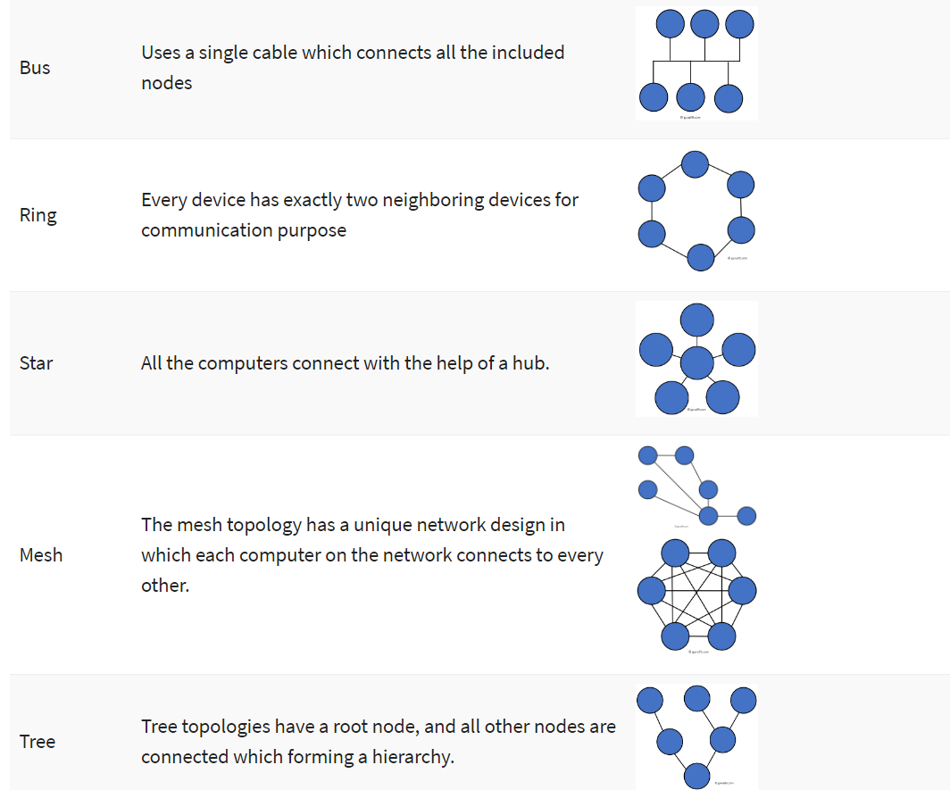
Describe the topologies star, bus, ring, mesh, tree

Slide 7
Why is the network protocol TCPIP used?
+ TCP/IP can be used to provide remote login over the network for interactive file transfer to deliver email, to deliver webpages over the network and to remotely access a server host's file system.
- When two computers wish to exchange information over a network, they need to use a protocol which defines the "rules of the road" that each computer must follow so that the systems on the network can exchange data.
- The most popular protocols in use today are undoubtedly Internet Protocol (IP) and Transmission Control Protocol (TCP), which is based on IP. The term TCP/IP is often loosely used to refer to the whole suite of protocols and applications that are based on these Internet Protocols.

Slide 8
Importance of security of files, folders, data, network access on a network
First when we talk about security the reason is we are looking for safety to protect our valuables "Importance of Network Security: Safety in the Digital World"
As the internet grows and computer networks become bigger, data integrity has become one of the most important aspects for organizations to consider.
Why is network security important?
While there is no network that is immune to attacks, a stable and efficient network security system is essential to protecting client data. A good network security system helps business reduce the risk of falling victim of data theft and sabotage. Also, Network security helps protect your workstations from harmful spyware. It also ensures that shared data is kept secure.
What is file security?
File security is all about safeguarding your business-critical information from prying eyes by implementing stringent access control measures and flawless permission hygiene.
Why is Data Security important?
Data is a valuable asset that generates, acquires, saves, and exchanges for anyone. Protecting it from internal or external corruption and illegal access protects from financial loss, reputational harm, consumer trust degradation, and brand erosion.

Slide 9
Utilities that should/can be used on a network e.g. virus protection, backup, remote desktop
• System Utilities:
The system utility software covers memory testers, network utilities, registry cleaners and anti-virus.
• File Management Utilities:
Archivers, backup software, data compression utilities and file managers fall in the category of File Management Utilities.
• Backup Utilities:
Backup utility software helps prepare a copy of databases, files and documents.
• Antivirus:
Antivirus or anti-malware is a threat detection tool designed for eliminating all types of viruses, malware, and other cyber threats from your devices.
• Backup Software:
Backup software creates a backup of files by preparing supplementary copies of databases and documents.
• Data Synchronization Tools:
These tools help synchronize the data between two and more devices.
• Disk Clean-Up Tool:
Disk clean-ups help clean the disk space within a system’s hard drive. It removes unwanted files from a system.
• Network Utilities:
Network utilities help configure a device’s network by checking data transfers, logging the events as well as configuring network settings.

Slide 10
Reasons for using network services e.g. login, account management, file/folder permissions
+Each network operating system manages permissions in a different way. Whatever the details, the effect is that you can give permission to each user to access certain files, folders, or drives in certain ways.
One of the control the use of system and network resources through the interrelated mechanisms of authentication and authorization.
Management of access rights is probably one of the most important aspects when securing your data.
The process can create, provision, and effectively manage different users, groups, roles, and policies.
Login for The user credentials connect the user’s identity to some sort of authenticity proof. The credentials can be a password, a certificate or even PIN number. They are collected through a logon user interface input or through an API and sent to the authenticating server.
Ability to simplify user provisioning process and setup accounts.

Slide 11
Why do individuals or groups of people use networks
From the very beginning I have to say , it should be mentioned about the differences, interest in communication, sharing, cooperation and being together; these are what make up the people and the public.
as our need and desire becomes greater than ever, the term is increasingly abused in marketing and PR(public relations). Misconceptions can quickly propagate, so I find it important that we look more carefully into the definitions.
I concentrated on the differences between groups, networks, and communities to keep this post concise.
A network is a web of interconnected personal relationships. For example, social media groups allow different individuals to communicate with one another through a dynamic web of relationships. Contrarily, a mailing list is a “channel” as it only allows for communication in one/two directions. “Sense of community is a feeling that members have of belonging, a feeling that members matter to one another and to the group, and a shared faith that members’ needs will be met through their commitment to be together” McMillan, 1976.
So, Now we have to say that network, in social science, a group of interdependent actors and the relationships between them. The Users within a network might be people, families, organizations, corporations, states, or a mixture of individuals and groups. The relationships between users within a network can vary from close ties such as those within a family to occasional impersonal or mediated interactions. Networks can exist in unstructured social environments as well as in highly formalized, rule-bound settings.

Slide 12
Source:
https://aws.amazon.com/what-is/computer-networking/
https://digitalworld839.com/types-of-networks-computer/
https://ipwithease.com/wired-network-vs-wireless-network/
https://ipwithease.com/wired-network-vs-wireless-network/
https://www.cisco.com/c/en/us/solutions/enterprise-networks/what-is-computer-networking.html
https://www.computer-solutions.co.uk/chipdev/tcpwnw.html
https://www.guru99.com/type-of-network-topology.html
https://www.ecpi.edu/blog/importance-of-network-security-safety-in-the-digital-world#:~:text=A%20good%20network%20security%20system,shared%20data%20is%20kept%20secure.
https://www.computer-solutions.co.uk/chipdev/tcpwnw.html
https://www.pcwdld.com/access-management#wbounce-modal
https://www.techjockey.com/blog/top-10-utility-software-tools
https://www.britannica.com/topic/network-sociology

Slide 13
Unit 11 Networking Task 1
Teacher: Majid Shah
Date:17/10/2022
Create by:Amir Jafari

